Slide 1



Project Presentation: Exploratory Data Analysis of Car Dekho Car Sales
INT 353 –EDA Project
John Pradeep Reddy Karri
12109211
RK21UTA15
Submitted to : Shivangini Gupta

Slide 2

Problem Statement
To Find Insights and Analyze the trends from the data of car sales of CAR DEKHO company and give solutions to improve their Business.

Slide 3

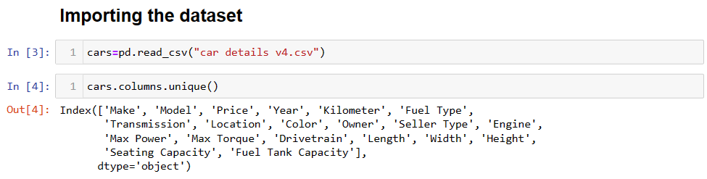
Data Collection
Collected data from Kaggle and imported it into jupyter notebook and coverted into a data frame to furthur processing and draw insights from the data.
https://www.kaggle.com/datasets/nehalbirla/vehicle-dataset-from-cardekho
This Photo by Unknown Author is licensed under CC BY-SA-NC

Slide 4
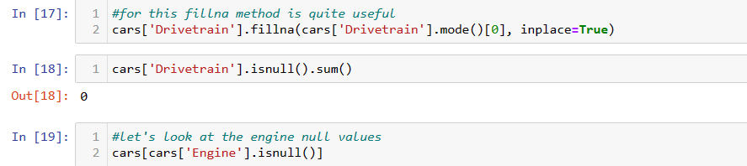
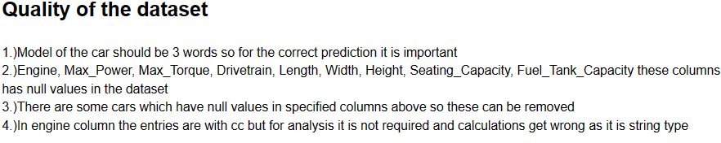
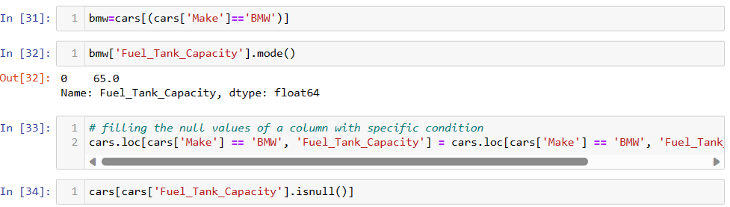
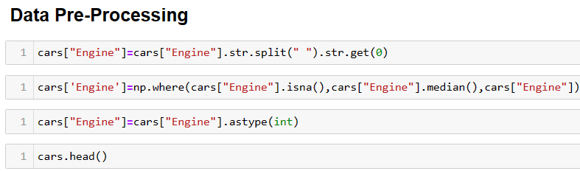
Data Cleaning and Preprocessing
The dataset has a lot of missing values and the rows and columns are not in correct format that they should be there. Some missing values like fuel tank capacity is repetitious fro specific models so I have to fill them from internet.

Slide 5
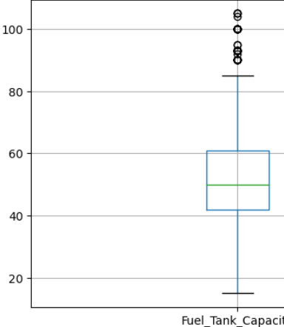
Treating NULL
Values
For treating the null values I followed both imputation, removal of the null values.
For this I fllowed Z-Score method to consider the outliers if they are out of specific range.
Also I have plotted boxplots for getting visual representation of the data distribution.
I haven’t cleared all the values because it will cause a data loss.
This Fuel Tank capacity column is after the clearing of the outliers although it may have some outliers I didn’t consider them as outliers as they are continuous.
I have spotted electric cars in the dataset but in less quantity as they are new in the market I removed them as they don’t have engine specifications. They can hamper the analysis of whole data.

Slide 6

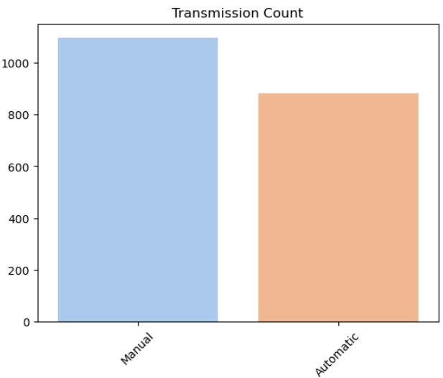
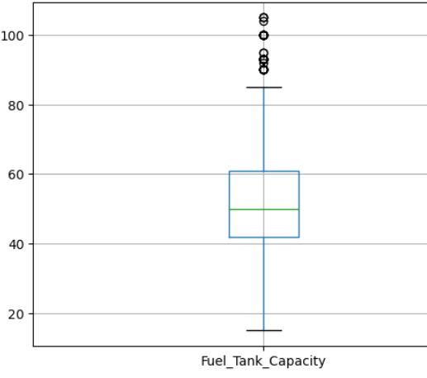
Exploratory Data
Analysis
1
Descriptive Statistics
Uncover key statistical measures that describe the central tendencies, variability, and distribution of the car sales data.
2
Data Visualization
Visualize the data through captivating charts and graphs that bring the insights to life, making the analysis both informative and visually appealing.

Slide 7

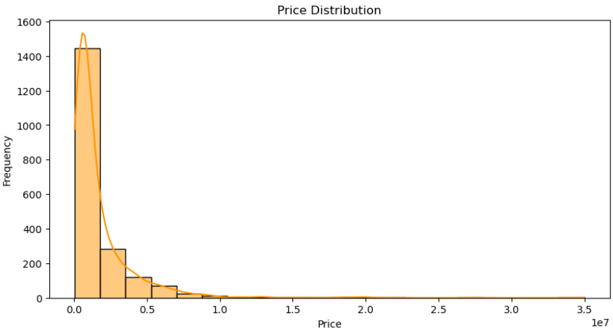
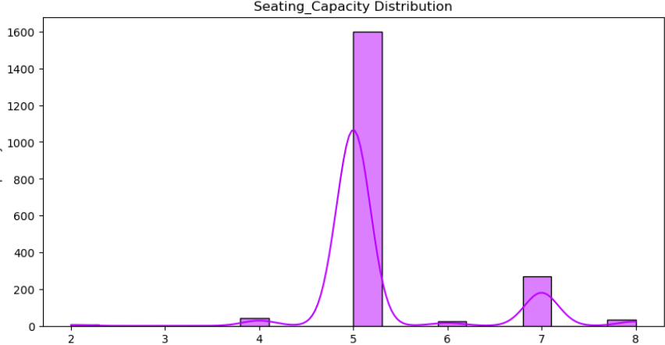
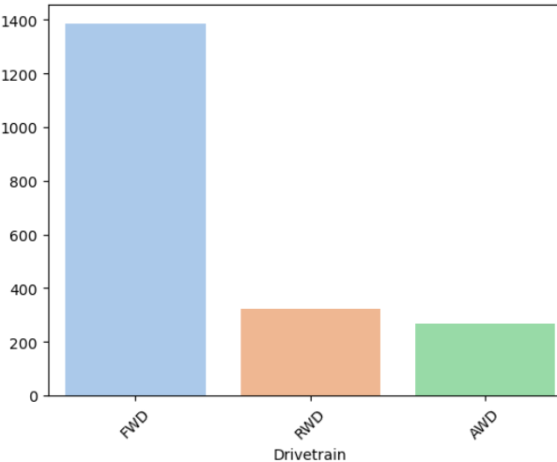
Univariate Analysis
I have analyzed all the columns individually. For numerical columns first I took all the descriptive statistics from the numerical columns and saw if any outliers are there and cleaned outliers by using Z-score method also I studied categorical columns by count plots and unique method in pandas library.

Slide 8
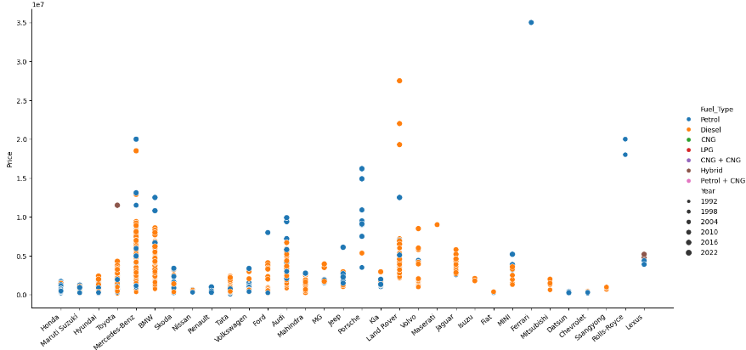

Relationship between two variables and explore how they interact and influence each other within the car sales dataset. I have used relplots for the columns like Keeping Price and Company as common and varying other features like Transmission and fuel type. This has been useful to see the patterns of some categorical columns.
Bivariate Analysis

Slide 9
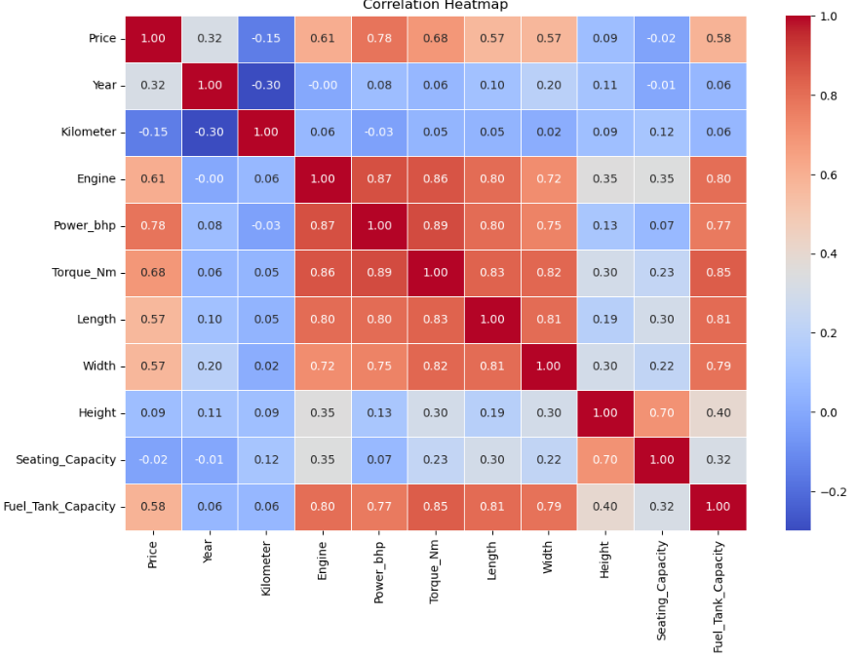
Multi Variate Analysis
complex analysis of multiple variables simultaneously to uncover intricate patterns, correlations, and dependencies within the car sales data.
For this I have ccreated eye catching heatmaps for correlation and covariance.
Although covariance isn’t standard method for seeing patterns but it helps in data understanding.

Slide 10
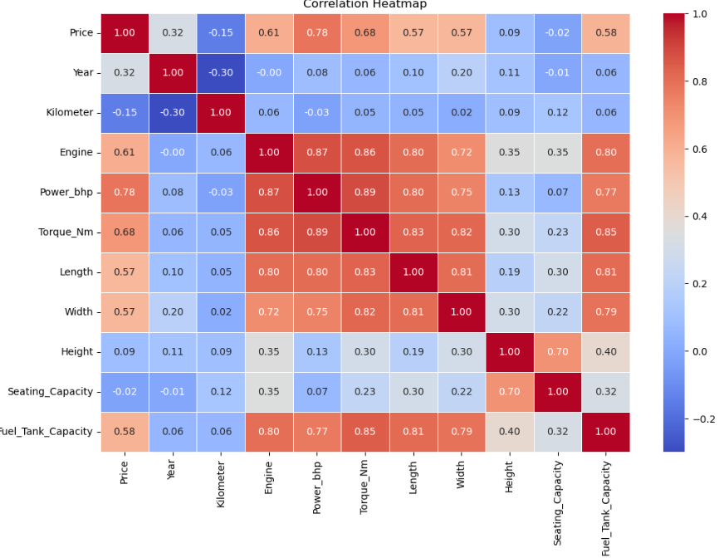
Correlation Heat
map
This heatmap gives almost all the understanding of the correlation between every column in the dataset. From this I came to know that price of the car is dependent more on Engine power and less on the other features.

Slide 11
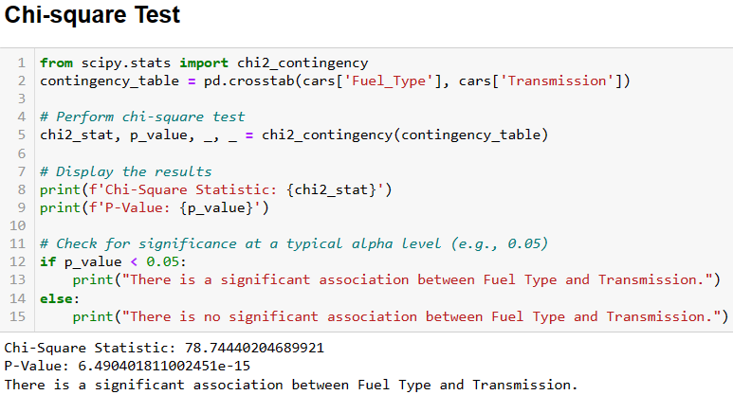
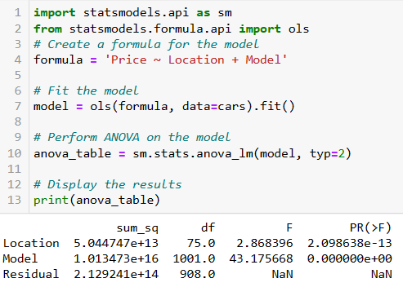
Hypothesis Testing
I have two hypothesis and I wanted to test them with all the tests like F,Z,T,Chisquared e.t.c the two hypothesis are:
The average price of diesel cars is significantly different from the average price of petrol cars.
There will be a significant difference in the price location wise for the same model of the car
After doing all the tests I got to knw that my first hypothesis is true but the second one not true in all the cases.

Slide 12

Key Findings
Analysis of Car Sales Data
There are significant differences in car prices across different locations. But this is a hypothesis this is true in only soe cases.
Insights and Trends
Every popular company which is making the budget cars in india is having larger sales and also the resale value is also very low. They are focusing more customers at less prices.
Customer Interests
Customers are more interested in cars in which engine capacity and pickup is good also they are more fascinated towards 5 seater cars as most of the sales are of this category and there seems to be city people who are working and studying are more interested in finding used cars.

Slide 13

Recommendations For Car Dekho.
Company need to focus more on sales in the metropolitan cities as they have good understanding in the delhi and Mumbai but some of the cities like Hyderabad, bengalore and Chennai and vizag sales are low.
Need to focus more on engine specifications of the cars as every customer
looks at the pickup of the car first. It contributes more on the resale price

Slide 14
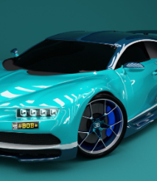
Future Scope of the project:
In order to continue improving the car sales process, there are several avenues for future research and analysis. These could include examining the impact of different marketing strategies, studying customer satisfaction levels over time, or analyzing the performance of specific car models.
Also considering this analysis we can deploy a Machine model to predict the car prices of the cars also using NLP and deep learning we can deploy a model which predicts the price of the car by uploading it’s images.

Slide 15
Thank You

